Slide 1
Java community
TDD Introduction
MCA Nederland
07/08/2018

Slide 2

Agenda
TDD
Introduction
What does it means ?
What is it ?
TDD Cycle
TDD Laws
TDD Quote
Simple live example
Conclusion

Slide 3

Introduction
TDD
Can you test your big decisions before doing it ?

Slide 4

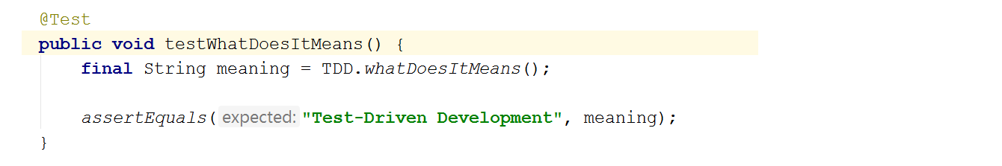
What does it means ?
TDD

Slide 5
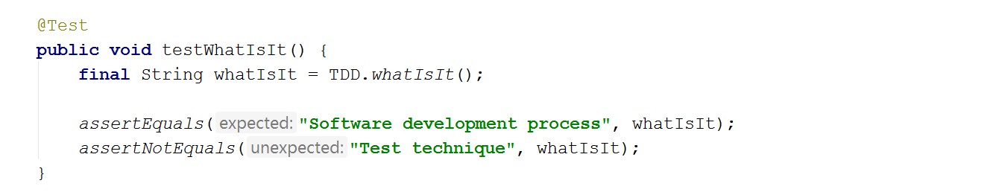
What is it ?
TDD

Slide 6

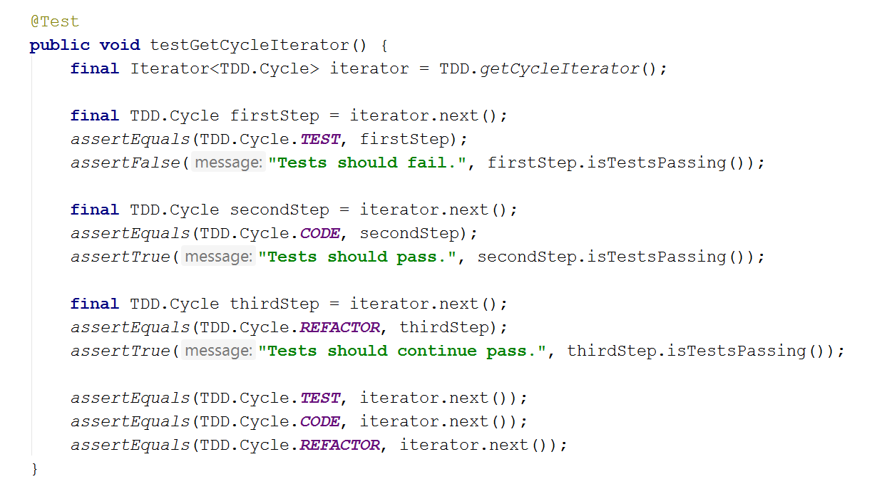
TDD Cycle
TDD

Slide 7
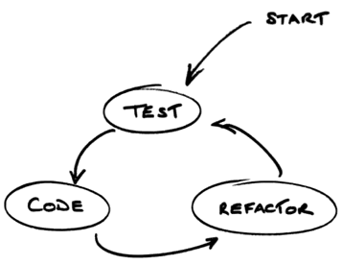
TDD Cycle
TDD

Slide 8
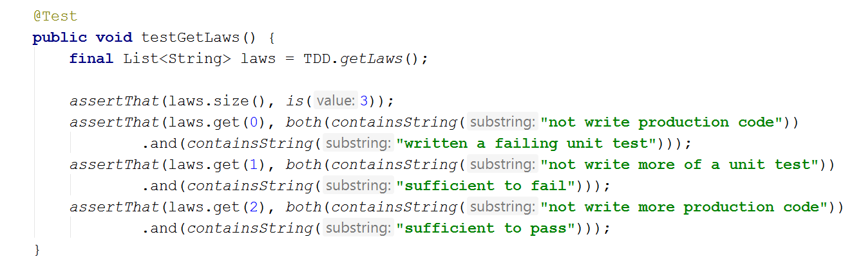
TDD Laws
TDD

Slide 9
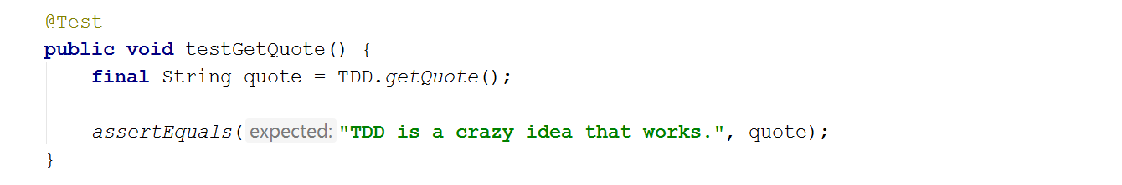
TDD Quote
TDD

Slide 10
Simple live example
TDD
Create a new method that returns the TDD author’s name

Slide 11
Conclusion
TDD
Today I learned ...

